Slide 1

Agile Project management
Presented by: David Burrell

Slide 2

Roles on a Scrum-Agile Team
Product Owner
Responsible for maximizing value of the product and work of the development team
Scrum Master
Responsible for ensuring Scrum is understood and enacted
Development Team
Responsible for delivering a potentially releasable increment of finished product at the end of each sprint

Slide 3

Product Owner
The Product Owner is responsible for:
Developing and maintaining a product vision and market strategy
Product development
Ordering and managing the product backlog
Involving stakeholders and end-users in product backlog refinement and management

Slide 4

Scrum Master
The Scrum Master acts as a:
Servant Leader whose focus is on the needs of the team members and those they serve
Facilitator by setting the stage and providing clear boundaries in which the team can collaborate
Mentor that transfers agile knowledge and experience to the team

Slide 5

Development Team
The Development Team has the following characteristics:
Self-organizing, they decide how to turn product backlog items into working solutions
Cross functional, they have all the skills necessary to create the product increment
Committed to achieving the sprint goal and delivering a high quality increment

Slide 6
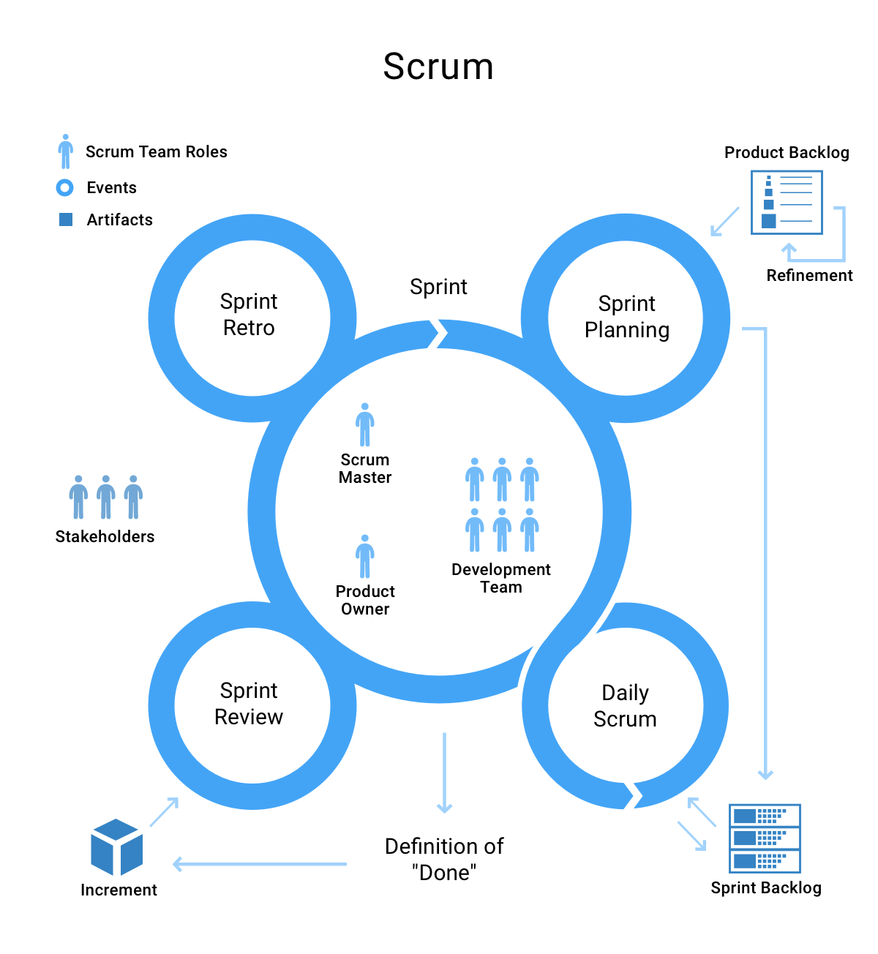
Sprint Planning
Sprint planning initiates the sprint by laying out the work to be performed for the sprint. The resulting plan is created by the collaborative work of the entire scrum team.

Slide 7
Daily Scrum
The purpose of the daily scrum is to inspect progress towards the sprint goal and adapt the sprint backlog as necessary, adjusting the upcoming planned work.

Slide 8
Sprint Review
The purpose of the sprint review is to inspect the outcome of the sprint and determine future adaptations. The scrum team presents the results of their work to key stakeholders and progress towards the product goal is discussed.

Slide 9
Sprint Retrospective
The purpose of the sprint retrospective is to plan ways to increase quality and effectiveness. The scrum team inspects how the last sprint went with regards to individuals, interactions, processes, tools, and their definition of done.

Slide 10

Waterfall Development Approach
Often considered the classic approach, the waterfall model describes a development method that is linear and sequential. Waterfall development has distinct goals for each phase of development. Once a phase of development is completed, the development proceeds to the next phase and there is no turning back.

Slide 11

Agile Development Approach
Agile software development model is based on multiple small teams working in an intensive and interdependent manner. The term scrum is named for the scrummage formation in rugby, which is used to restart the game after an event that causes play to stop, such as an infringement. Scrum employs real-time decision-making processes based on actual events and information.

Slide 12

Thank You!
Reference
Cobb, C. G. (2015). The Project Manager’s Guide to Mastering Agile: Principles and Practices for an Adaptive Approach (1st ed.). Wiley.

